Slide 1
UVM TLM Introduction
Chen-Hsiung Liu
2026/8/10

Slide 2
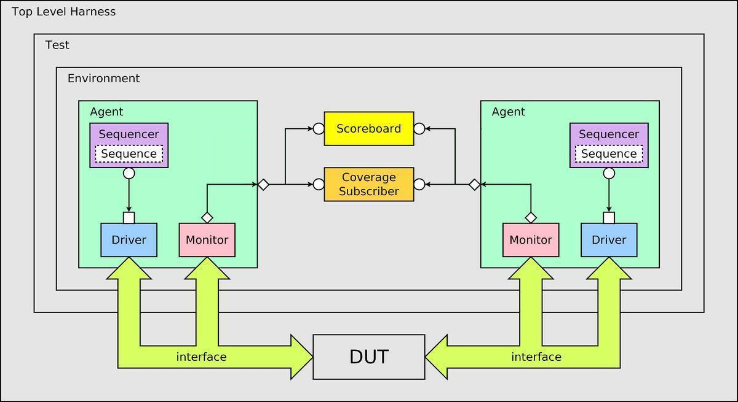
UVM Testbench Architecture
Notes:
https://csbearnokiseki.blogspot.com/2017/06/uvm.html

Slide 3
Communication in UVM: TLM 1.0, 2.0
TLM Classes – 1.0
  uvm_*_port
  uvm_*_export
  uvm_*_imp
  uvm_*_fifo
TLM Classes – 2.0
  uvm_*_socket
env
sequencer
sequence
driver

Slide 4
UVM TLM 1.0
Push
Pull
Fifo
Analysis
(broadcast)
put_producer
calls port.put()
put_consumer
implements put()
pull_consumer
implements pull()
pull_producer
calls port.pull()
producer calls port.put()
FIFO
consumer calls
port.pull()
write_producer
calls port.write()
write_subscriber
implements write()
write_subscriber
implements write()
write_subscriber
implements write()

Slide 5
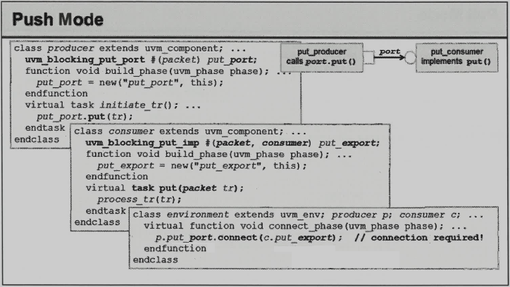

Slide 6
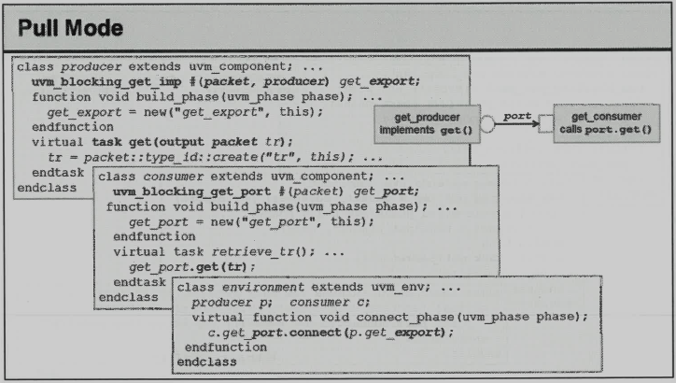

Slide 7
TLM Port methods
virtual function bit can_*()
Returns 1 if a new transaction is available; 0 otherwise.
Class \ Method | put | try_put | can_put | get | try_get | can_get | peek | try_peek | can_peek | write
uvm_blocking_put_port | V
uvm_nonblocking_put_port |  | V | V
uvm_put_port | V | V | V
uvm_blocking_get_port |  |  |  | V
uvm_nonblocking_get_port |  |  |  |  | V | V
uvm_get_port |  |  |  | V | V | V
uvm_blocking_peek_port |  |  |  |  |  |  | V
uvm_nonblocking_peek_port |  |  |  |  |  |  |  | V | V
uvm_peek_port |  |  |  |  |  |  | V | V | V
uvm_blocking_get_peek_port |  |  |  | V |  |  | V
uvm_nonblocking_get_peek_port |  |  |  |  | V | V |  | V | V
uvm_get_peek_port |  |  |  | V | V | V | V | V | V
uvm_blocking_master_port | V |  |  | V |  |  | V
uvm_nonblocking_master_port |  | V | V |  | V | V |  | V | V
uvm_master_port | V | V | V | V | V | V | V | V | V
uvm_blocking_slave_port | V |  |  | V |  |  | V
uvm_nonblocking_slave_port |  | V | V |  | V | V |  | V | V
uvm_slave_port | V | V | V | V | V | V | V | V | V
uvm_analysis_port |  |  |  |  |  |  |  |  |  | V

Slide 8
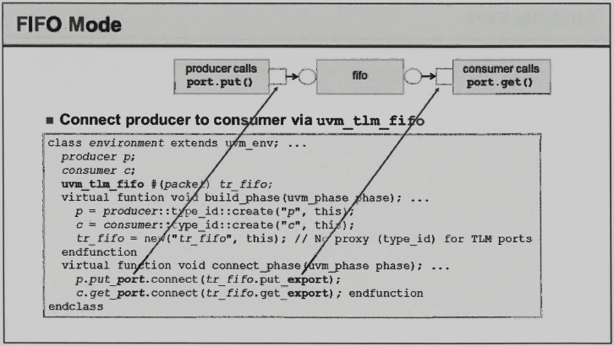



Slide 9
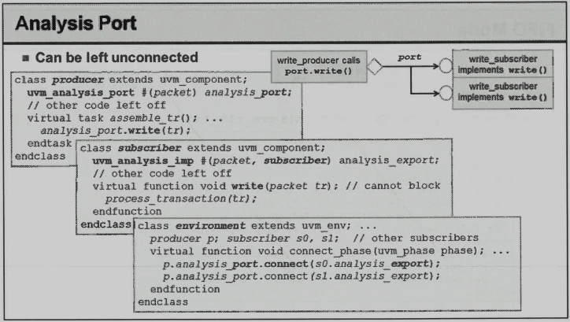

Slide 10
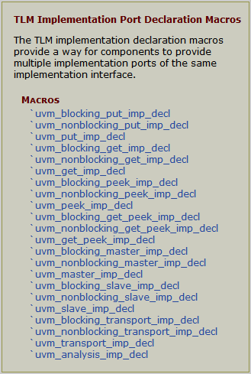
TLM Imp Port Declaration Macros (1)
// Define two new put interfaces which are compatible with uvm_put_ports
// and uvm_put_exports.
`uvm_put_imp_decl(_1)
`uvm_put_imp_decl(_2)
class my_put_imp#(type T=int) extends uvm_component;
uvm_put_imp_1#(T, my_put_imp#(T)) p1_put_export;
uvm_put_imp_2#(T, my_put_imp#(T)) p2_put_export;
// ...
virtual task put_l (input T t);
// puts coming into put_impl
endtask
virtual task put_2(input T t);
// puts coming into put_imp2
endtask
endclass

Slide 11
TLM Imp Port Declaration Macros (2)
`uvm_analysis_imp_decl(_ingress)
`uvm_analysis_imp_decl(_egress)
class myscoreboard extends uvm_component;
uvm_analysis_imp_ingress#(mydata, myscoreboard) ingress_analysis_export;
uvm_analysis_imp_egress #(mydata, myscoreboard) egress_analysis_export;
mydata ingress_list[$];
// ...
function new (string name, uvm_component parent);
super.new(name, parent);
ingress_analysis_export = new("ingress_analysis_export", this);
egress_analysis_export = new("egress_analysis_export", this);
endfunction
function void write_ingress (mydata t);
ingress_list.push_back(t);
endfunction
function void write_egress (mydata t);
find_match_in_ingress_list(t);
endfunction
function void find_match_in_ingress_list (mydata t);
// implement scoreboarding for this particular dut
endfunction
endclass

Slide 12
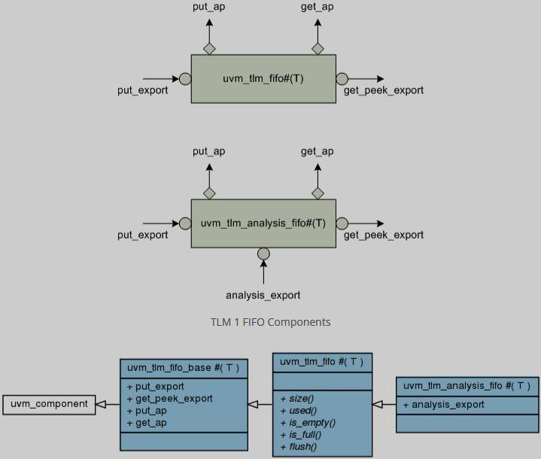
UVM TLM FIFO
default size = 1
default size = 0, unbounded
(uvm_analysis_imp)

Slide 13
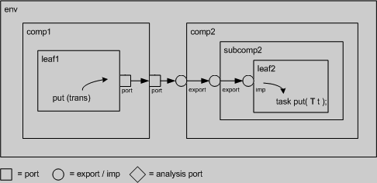
TLM connect
Hierarchical port connections are resolved and optimized just before uvm_component::end_of_elaboration_phase. After optimization, calling any port’s interface method (e.g. leaf1.out.put(trans)) incurs a single hop to get to the implementation (e.g. leaf2’s put task), no matter how far up and down the hierarchy the implementation resides.
port-to-port | leaf1’s out port is connected to its parent’s (comp1) out port
port-to-export | comp1’s out port is connected to comp2’s in export
export-to-export | comp2’s in export is connected to its child’s (subcomp2) in export
export-to-imp | subcomp2’s in export is connected leaf2’s in imp port.
imp-to-implementation | leaf2’s in imp port is connected to its implementation, leaf2

Slide 14
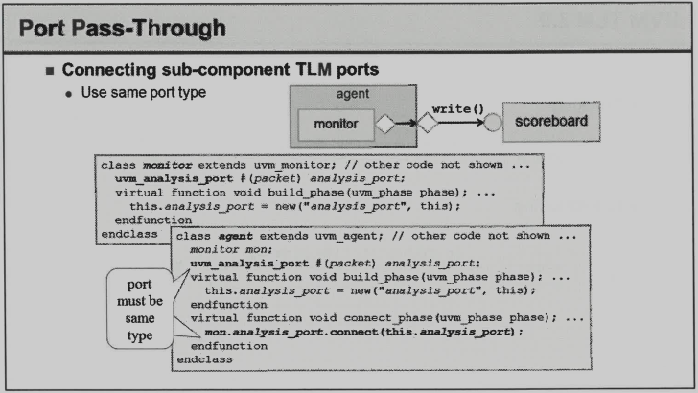

Slide 15
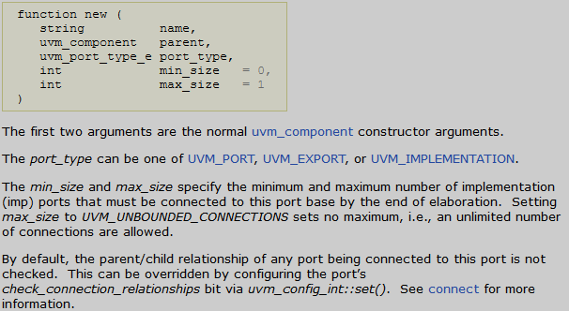
Port Base Class
uvm_port_base #(IF)
The debug_connected_to method outputs a visual text display of the port/export/imp network to which this port connects (i.e., the port’s fanout).
The debug_provided_to method outputs a visual display of the port/export network that ultimately connect to this port (i.e., the port’s fanin).

Slide 16
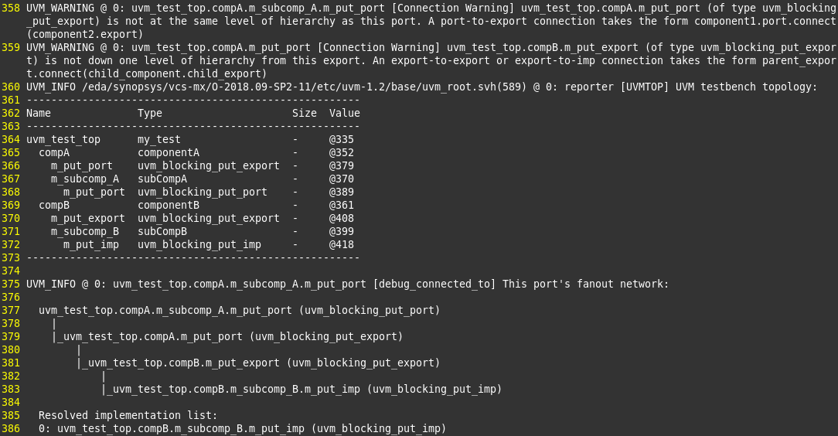
Check and Debug Connection

Slide 17
UVM built-in check
Size check uses size() to get the number of implementation ports connected to this port.
`UVM_PORT_COMMON, `UVM_EXPORT_COMMON, `UVM_IMP_COMMON, default min_size=1, max_size=1.
uvm_analysis_port, default min_size=0, max_size=unbounded.
uvm_analysis_export, default min_size=1, max_size=unbounded.
uvm_analysis_imp, default min_size=1, max_size=1.
Error message example:
[Connection Error] connection count of 0 does not meet required minimum of 1
[Connection Error] connection count of 2 exceeds maximum of 1

Slide 18
TLM Connection Example (1)
This is legal.
env
compA1
compB1
subcompA
subcompB
compA2
compB2
subcompA
subcompB

Slide 19
TLM Connection Example (2)
This is legal.
env
compA1
compB1
subcompA
subcompB
compA2
compB2
subcompA
subcompB

Slide 20
TLM Connection Example (3)
This is illegal.
env
compA1
compB1
subcompA
subcompB
compA2
compB2
subcompA
subcompB

Slide 21
TLM Connection Example (4)
This is legal. (not recommended)
env
agent
scoreboard
uvm_tlm_analysis_fifo
get()
analysis_export
monitor

Slide 22
UVM TLM 2.0
Blocking
Non-blocking
b_transport (tx, delay)
initiator
target
nb_transport_fw (tx, p, delay)
initiator
target
nb_transport_bw (tx, p, delay)

Slide 23
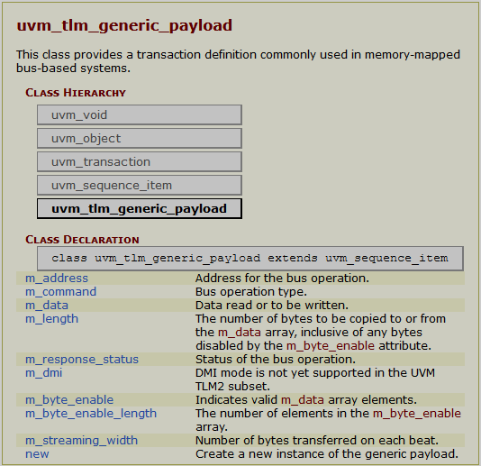
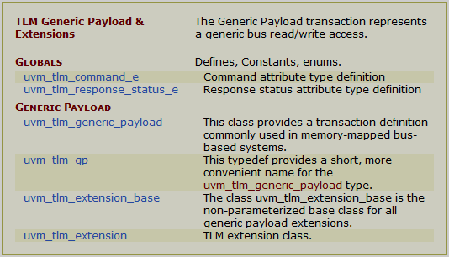
TLM 2.0 Generic Payload

